Slide 1


TITLE
SUPERNOVAS_EXCELRS-MEDICAL-CREW
SUBTITLE :-
Smart Patient Interaction Using AI Agents
PRESENTED BY :-
TEAM - SUPERNOVAS

Slide 2

Introduction
Healthcare Sector Is Moving Towards Digital Transformation
Patients Face Delay In Getting Basic Medical Guidance
AI Agent Can Provide Instant Support

Slide 3


Problem Statement
Hospitals Receive Thousands Of Patients Queries Daily
Doctors & Staff Members Are Overloaded
Patient Wait For Simple Answers
No 24*7 Support System

Slide 4

Proposed Solution
Two AI Agents
Enquiry Agent (Patient Side)
Advisor Agent (Medical Guidance Side)

Slide 5

1. Enquiry Agent
Allows Patient To Enter Their Symptoms
Collect Medical History From The Patient
Gathers Basic Details Regarding The Symptoms
Accepts Patient Questions In Easy To Understand Language

Slide 6

2. Advisor Agent
Analyses The Patient’s Provided Data
Identifies Possible Causes Of the Symptoms
Suggests Basic Precaution And Self-care Tips
Advises Whether a Doctor’s Visit Is Required Or Not

Slide 7
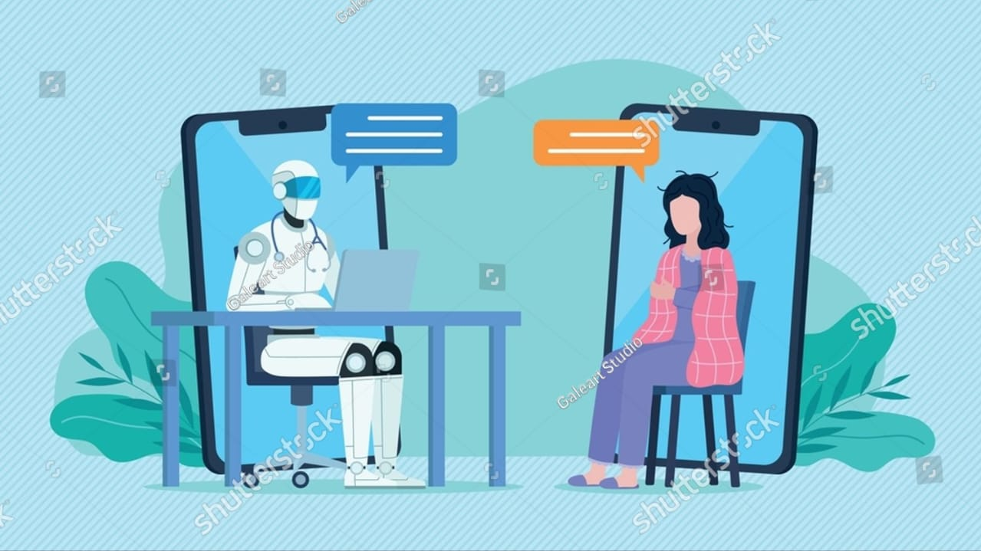
System Workflow
Patient – Talks To Enquiry Agent
Enquiry Agent – Collects All Data
Advisor Agent – Applies Medical Logic
Patient – Receives Medical Advice

Slide 8






Technologies Used
Frontend :- HTML, CSS, JavaScript, Bootstrap
Backend :- Python
AI Agentic Framework :- Crew AI

Slide 9

Benefits Of System
24*7 Medical Assistance
Reduced Workload For Doctors
Faster Patient Response
Free Healthcare Guidance
Easy Hospital Management

Slide 10
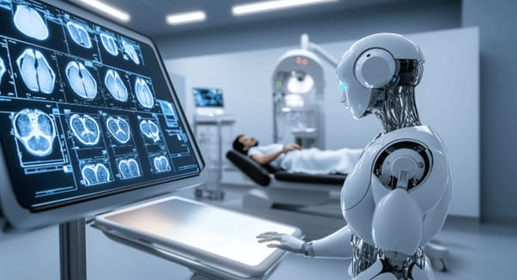
Use Cases
Hospital Enquiry Desk
Telemedicine Platforms
Rural Healthcare Centres

Slide 11

Future Scope
Doctor Appointment Booking
Medical Report Analysis
Voice Based Interaction
Multi-Language Support

Slide 12
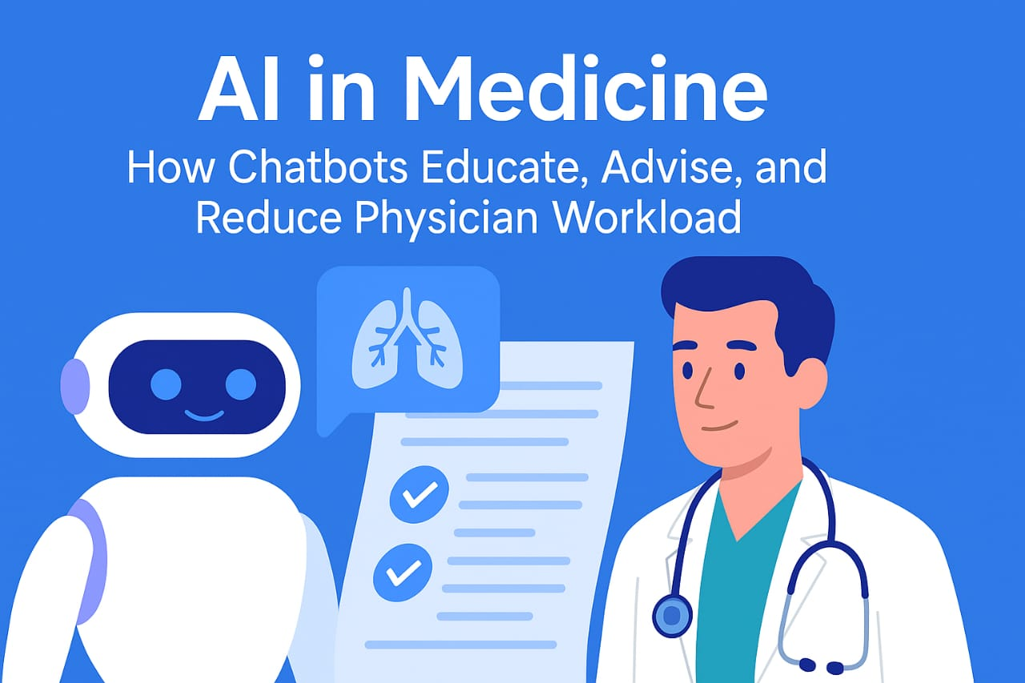
Conclusion
Improve Patient Experience
Reduce Hospital Workload
Supports Doctor Efficiently

Slide 13

Thank You

